Slide 1
Further info for modelling

Slide 2
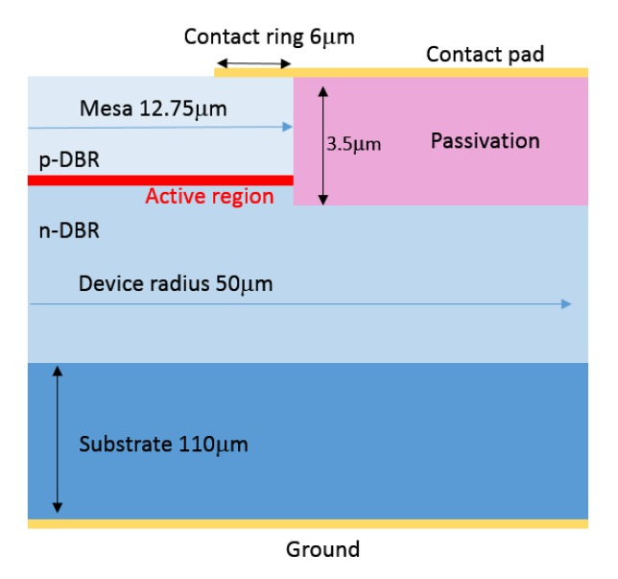
Device geometry
Acutal values
Mesa radius = Active radius + 11.5µm
So mesa diameter = 28µm for a 5µm active device
P-contact inner diameter 9,3µm
P-contact outder diameter 22µm
No passivation
Chip Size 200µm x 400µm
Substrate thickness 150µm
Example of needed info:

Slide 3
Far field algorithm
TBD

Slide 4
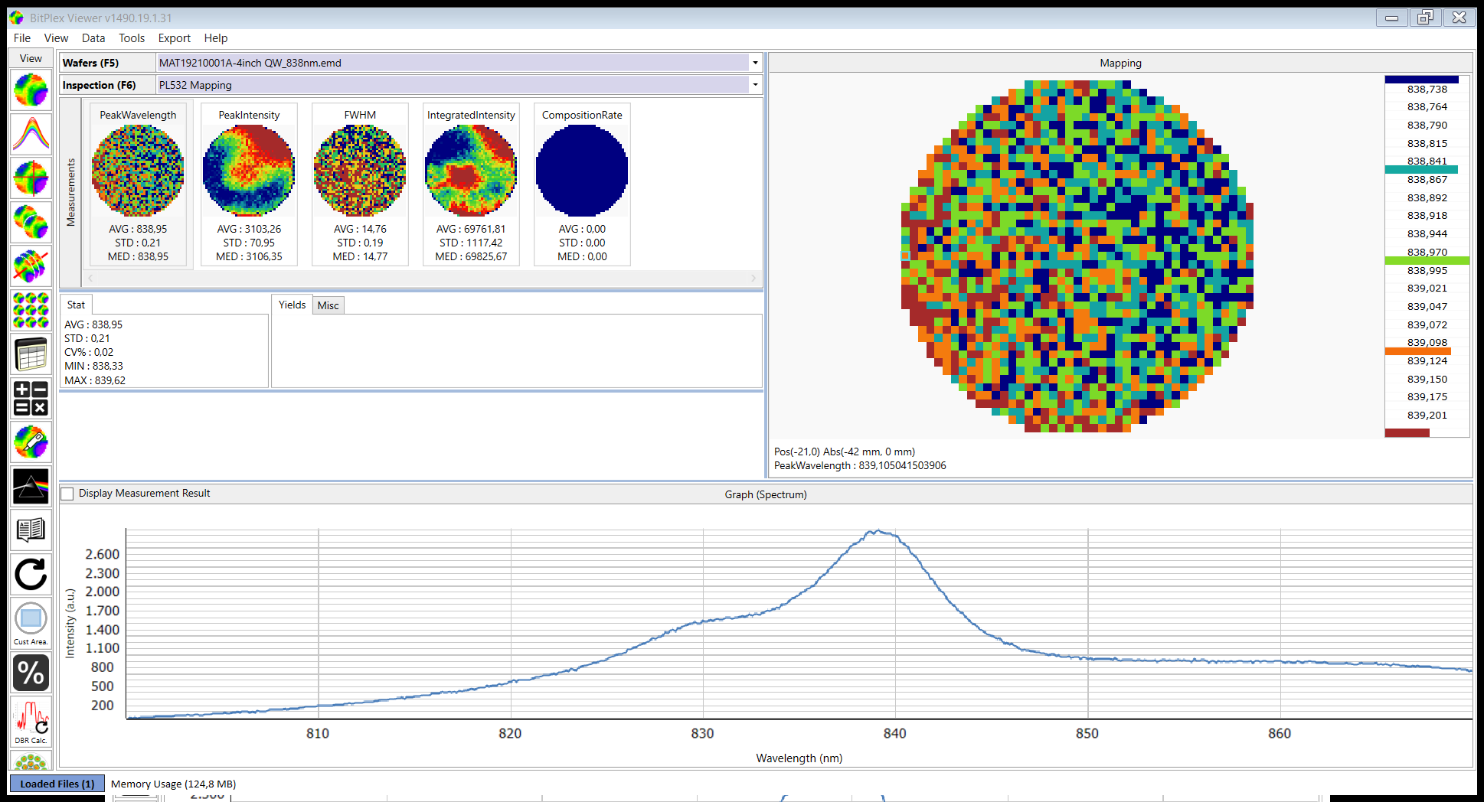
PL spectrum
Raw data: P-TPC Qyro - General\WP2 EPI Development\Simulations\CNR\Qyro_Shared_Folder_CNR\Simulation of single elements SAMOS
PL-Spektrum_MAT19210001A_0_0.txt

Slide 5
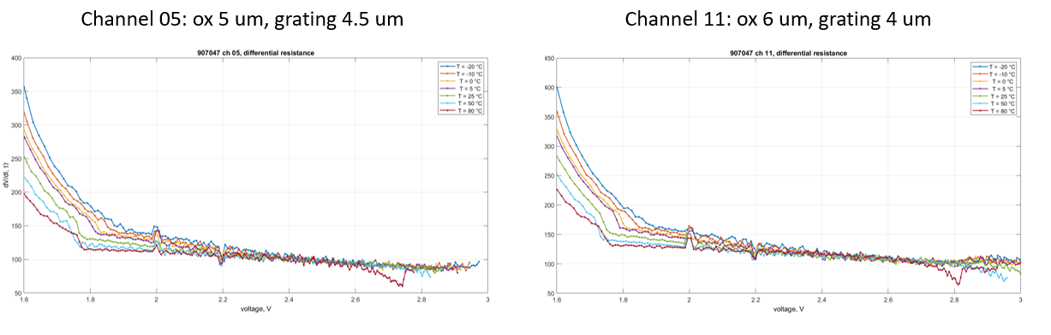
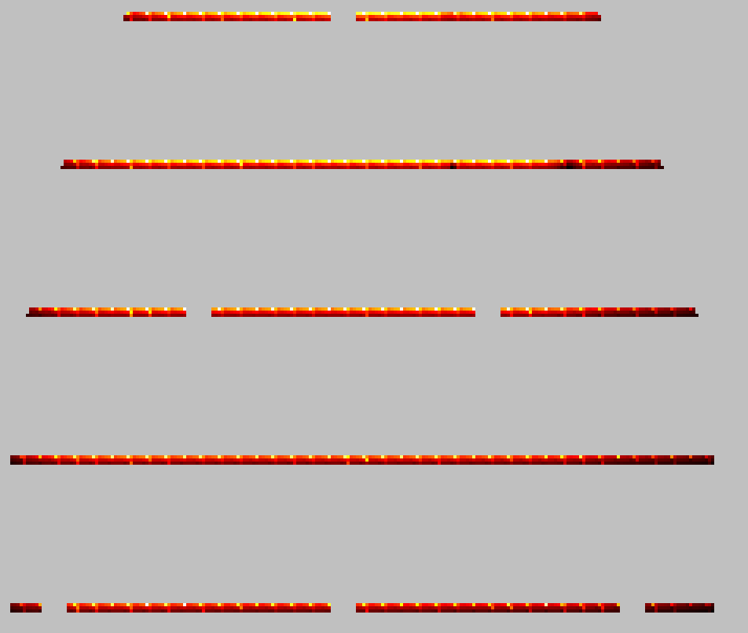
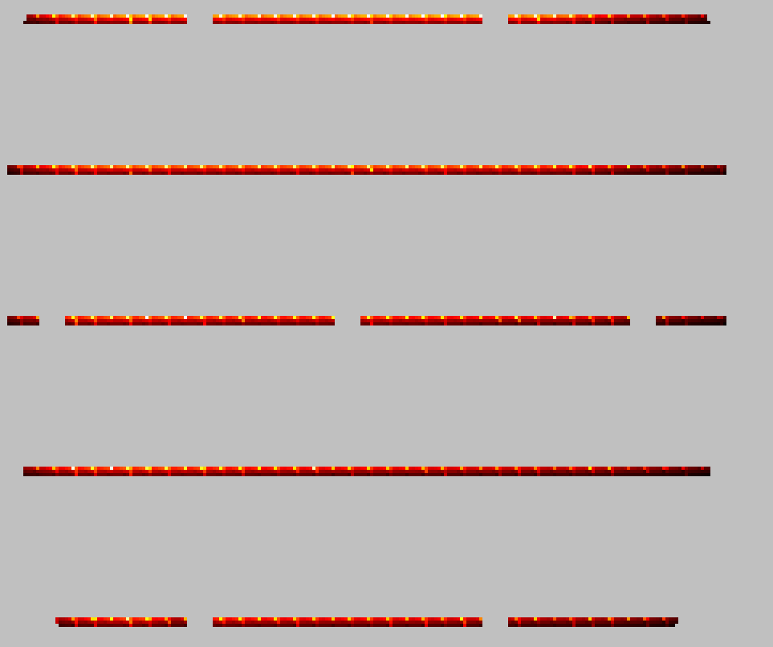
Chip ID of SAMOS devices and difference in series resistance over the wafer
Wafer 31930_002A
Spalte 125
Zeile 375
R_diff = 0.122
Wafer 31930_002A
Spalte 125
Zeile 94
R_diff = 0.132
Next 5µm device
R_diff = 0.177
Region of high series resistance
Region of low series resistance

